Slide 1
Greedy algorithms
David Kauchak
cs140
Spring 2024

Slide 2
Administrative
Assignment 6
Grades
Dr. Dave’s grades

Slide 3
Greedy algorithms
Algorithm that makes a local decision with the goal of creating a globally optimal solution
Method for solving problems where optimal solutions can be defined in terms of optimal solutions to sub-problems

Slide 4
Greedy
Greedy
To solve the general problem:
Pick a locally optimal solution and repeat

Slide 5
Horn formula
A horn formula is a set of implications and negative clauses:

Slide 6

Horn formula
A horn formula is a set of implications and negative clauses:
$$p q p ⇒q$$
LHS: positive literals anded
RHS: single positive literal
T
T
F
F
T
F
T
F
T
F
T
T

Slide 7
Horn formula
A horn formula is a set of implications and negative clauses:
Negated literals ored

Slide 8
Goal
Given a horn formula, determine if the formula is satisfiable, i.e., an assignment of true/false to the variables that is consistent with all the implications/causes
u x y z
0 1 1 0

Slide 9
A greedy solution?
w 0
x 0
y 0
z 0

Slide 10
A greedy solution?
w 0
x 1
y 0
z 0

Slide 11
A greedy solution?
w 0
x 1
y 1
z 0

Slide 12
A greedy solution?
w 1
x 1
y 1
z 0

Slide 13
A greedy solution?
w 1
x 1
y 1
z 0
not satisfiable

Slide 14
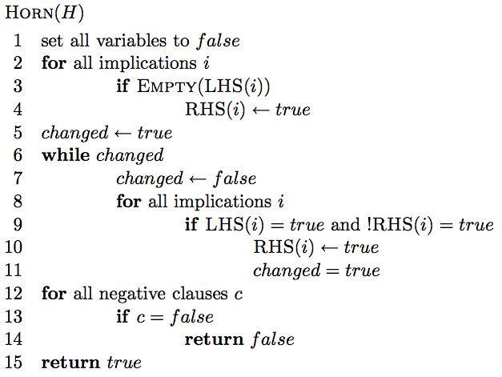
A greedy solution

Slide 15
A greedy solution
set all variables of the implications of the form “⇒x” to true

Slide 16
A greedy solution
if the all variables of the lhs of an implication are true, then set the rhs variable to true

Slide 17
A greedy solution
see if all of the negative clauses are satisfied

Slide 18
A greedy solution
How is this a greedy algorithm?

Slide 19
A greedy solution
How is this a greedy algorithm?
Make a greedy decision about which variables to set and then moves on

Slide 20
Correctness of greedy solution
Two parts:
If our algorithm returns an assignment, is it a valid assignment?
If our algorithm does not return an assignment, does an assignment exist?

Slide 21
Correctness of greedy solution
If our algorithm returns an assignment, is it a valid assignment?

Slide 22
Correctness of greedy solution
If our algorithm returns an assignment, is it a valid assignment?
explicitly check all negative clauses

Slide 23
Correctness of greedy solution
If our algorithm returns an assignment, is it a valid assignment?
don’t stop until all implications with all lhs elements true have rhs true

Slide 24
Correctness of greedy solution
If our algorithm does not return an assignment, does an assignment exist?
Our algorithm is “stingy”. It only sets those variables that have to be true. All others remain false.

Slide 25
Correctness of greedy solution
If our algorithm does not return an assignment, does an assignment exist?

Slide 26
Running time?
?
n = number of variables
m = number of formulas

Slide 27
Running time?
O(nm)
n = number of variables
m = number of formulas

Slide 28
Data compression
Given a file containing some data of a fixed alphabet Σ (e.g., A, B, C, D), we would like to pick a binary character code that minimizes the number of bits required to represent the data.
minimize the size of the encoded file
A C A D A A D B …
0010100100100 …

Slide 29
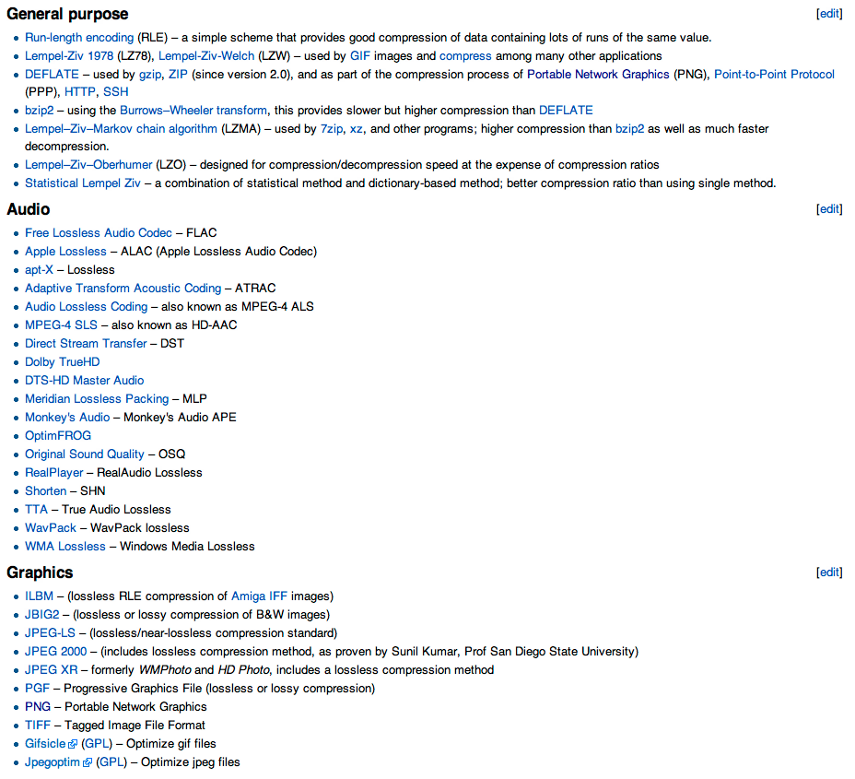
Compression algorithms
http://en.wikipedia.org/wiki/Lossless_data_compression

Slide 30
Simplifying assumption: frequency only
Assume that we only have character frequency information for a file
A C A D A A D B …
Symbol | Frequency
A B C D | 70 3 20 37
=

Slide 31
Fixed length code
Use $\left\lceil log2\left|Σ\right|\right\rceil$ bits for each character
A = B = C = D =

Slide 32
Fixed length code
Use $\left\lceil log2\left|Σ\right|\right\rceil$ bits for each character
Symbol | Frequency
A B C D | 70 3 20 37
A = 00 B = 01 C = 10 D = 11
2 x 70 + 2 x 3 + 2 x 20 + 2 x 37 =
260 bits
How many bits to encode the file?

Slide 33
Fixed length code
Use $\left\lceil log2\left|Σ\right|\right\rceil$ bits for each character
Symbol | Frequency
A B C D | 70 3 20 37
A = 00 B = 01 C = 10 D = 11
2 x 70 + 2 x 3 + 2 x 20 + 2 x 37 =
260 bits
Can we do better?

Slide 34
Variable length code
What about:
Symbol | Frequency
A B C D | 70 3 20 37
A = 0 B = 01 C = 10 D = 1
1 x 70 + 2 x 3 + 2 x 20 + 1 x 37 =
153 bits
How many bits to encode the file?

Slide 35
Decoding a file
A = 0 B = 01 C = 10 D = 1
010100011010
What characters does this sequence represent?

Slide 36
Decoding a file
A = 0 B = 01 C = 10 D = 1
010100011010
A D or B?
What characters does this sequence represent?

Slide 37
Variable length code
What about:
Symbol | Frequency
A B C D | 70 3 20 37
A = 0 B = 100 C = 101 D = 11
Is it decodeable?

Slide 38
Variable length code
What about:
Symbol | Frequency
A B C D | 70 3 20 37
A = 0 B = 100 C = 101 D = 11
1 x 70 + 3 x 3 + 3 x 20 + 2 x 37 =
213 bits (18% reduction)
How many bits to encode the file?

Slide 39
Prefix codes
A prefix code is a set of codes where no codeword is a prefix of any other codeword
A = 0 B = 01 C = 10 D = 1
A = 0 B = 100 C = 101 D = 11

Slide 40
Prefix tree
We can encode a prefix code using a full binary tree where each leaf represents an encoding of a symbol
0
1
A = 0 B = 100 C = 101 D = 11
A
D
B
C

Slide 41
Decoding using a prefix tree
To decode, we traverse the graph until a leaf node is reached and output the symbol
0
1
A = 0 B = 100 C = 101 D = 11
A
D
B
C

Slide 42
Decoding using a prefix tree
Traverse the graph until a leaf node is reached and output the symbol
0
1
1000111010100
A
D
B
C

Slide 43
Decoding using a prefix tree
Traverse the graph until a leaf node is reached and output the symbol
0
1
1000111010100
B
A
D
B
C

Slide 44
Decoding using a prefix tree
Traverse the graph until a leaf node is reached and output the symbol
0
1
1000111010100
B A
A
D
B
C

Slide 45
Decoding using a prefix tree
Traverse the graph until a leaf node is reached and output the symbol
0
1
1000111010100
B A D
A
D
B
C

Slide 46
Decoding using a prefix tree
Traverse the graph until a leaf node is reached and output the symbol
0
1
1000111010100
B A D C
A
D
B
C

Slide 47
Decoding using a prefix tree
Traverse the graph until a leaf node is reached and output the symbol
0
1
1000111010100
B A D C A
A
D
B
C

Slide 48
Decoding using a prefix tree
Traverse the graph until a leaf node is reached and output the symbol
0
1
1000111010100
B A D C A B
A
D
B
C

Slide 49
Determining the cost of a file
Symbol | Frequency
A B C D | 70 3 20 37
0
1
A
D
B
C

Slide 50
Determining the cost of a file
Symbol | Frequency
A B C D | 70 3 20 37
0
1
A
70
D
37
B
C
3
20

Slide 51
Determining the cost of a file
Symbol | Frequency
A B C D | 70 3 20 37
0
1
A
70
60
D
If we label the internal nodes with the sum of the children…
23
37
B
C
3
20

Slide 52
Determining the cost of a file
Symbol | Frequency
A B C D | 70 3 20 37
0
1
A
70
60
D
Cost is equal to the sum of the internal nodes (excluding the root) and the leaf nodes
23
37
B
C
3
20

Slide 53
Determining the cost of a file
As we move down the tree, one bit gets read for every nonroot node
0
1
70 times we see a 0 by itself
60 times we see a prefix that starts with a 1
A
70
60
of those, 37 times we see an additional 1
D
23
37
the remaining 23 times we see an additional 0
B
C
of these, 20 times we see a last 1 and 3 times a last 0
3
20

Slide 54
A greedy algorithm?
Given file frequencies, can we produce a prefix-free encoding (i.e., build a prefix tree) that minimizes the number of bits?
0
1
A
Symbol | Frequency
A B C D | 70 3 20 37
D
B
C
Where should the highest frequency items be?
Notes:
Top of the tree and the lowest frequency things at the bottom of the tree.

Slide 55
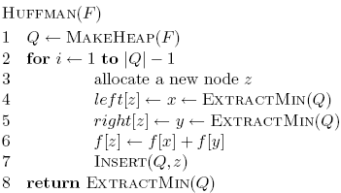
A greedy algorithm?
Given file frequencies, can we come up with a prefix-free encoding (i.e. build a prefix tree) that minimizes the number of bits?

Slide 56
Symbol | Frequency
A B C D | 70 3 20 37
Heap

Slide 57
Symbol | Frequency
A B C D | 70 3 20 37
Heap
B 3 C 20 D 37 A 70

Slide 58
Symbol | Frequency
A B C D | 70 3 20 37
Heap
merging with this node will incur an additional cost of 23
BC 23 D 37 A 70
23
B
C
3
20

Slide 59
Symbol | Frequency
A B C D | 70 3 20 37
Heap
BCD 60 A 70
60
D
23
37
B
C
3
20

Slide 60
Symbol | Frequency
A B C D | 70 3 20 37
Heap
A
ABCD 130
60
70
D
23
37
B
C
3
20

Slide 61
What is the code (assume left = 0)?
Symbol | Frequency
A B C D | 70 3 20 37
A
60
70
D
23
37
B
C
3
20

Slide 62
What is the code (assume left = 0)?
Symbol | Frequency
A B C D | 70 3 20 37
A
A: 1 B: 000 C: 001 D: 01
60
70
D
23
37
B
C
3
20

Slide 63
Proving correctness
The algorithm selects the symbols with the two smallest frequencies first (call them f₁ and f₂)

Slide 64
Proving correctness: proof by contradiction
The algorithm selects the symbols with the two smallest frequencies first (call them f₁ and f₂)
Consider a tree that did not do this:
Is it optimal?
f₁
f_{i}
f₂

Slide 65
Proving correctness
The algorithm selects the symbols with the two smallest frequencies first (call them f₁ and f₂)
Consider a tree that did not do this:
- frequencies don’t change - cost will decrease since f₁ < f_{i}
f₁
f_{i}
f_{i}
f₂
f₁
f₂
contradiction

Slide 66
Runtime?
1 call to MakeHeap
2(n-1) calls ExtractMin
n-1 calls Insert
O(n log n)

Slide 67
Non-optimal greedy algorithms
All the greedy algorithms we’ve looked at so far give the optimal answer
Some of the most common greedy algorithms generate good, but non-optimal solutions
set cover
clustering
hill-climbing
relaxation

Slide 68
Handout

Slide 69
Decoding using a prefix tree
Traverse the graph until a leaf node is reached and output the symbol
0
1
1000111010100
A
D
B
C

Slide 70
Symbol | Frequency
A B C D E | 5 20 10 13 9
Heap
What is the tree?
What is the encoding?
How many bits to encode the file?

